Slide 1
ENDEAVOUR HACKATHON- 2019
TEAM MEMBERS
SARVESH MAURYA
MOHD UZAIR
SUMIT BHARDWAJ
AMAN ABBAS

Slide 2
ADAPTIVE
TRAFFIC CONTROL

Slide 3
What is ADAPTIVE traffic control ?
It is a traffic controlling process which involves all the logical thinking and condition used by a TRAFFIC POLICEMAN i.e. HUMAN BRAIN.

Slide 4
ABSTRACT
Adaptive traffic signal control system presents an intelligent system using density detecting technique with the help of specialized algorithm needed to avoid traffic congestion. In this density detecting technique, the vehicles are detected, recognized and density is calibrated for controlling traffic density. This is the one of the most reliable and upcoming technology in the road transit system.

Slide 5
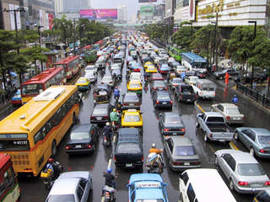

Slide 6
Need of Adaptive Traffic Control:
At present we use the basic fixed time controlled sequential signal system.
The current traffic system is inefficient due to randomness in the TRAFFIC DENSITY Pattern through out the day.
The flow gets choked when the traffic is not in signal’s fixed sequence.

Slide 7
Disadvantages of present scenario:
Time and fuel loss.
Easily signals are broken.
Chaos and traffic chocking takes place.

Slide 9
Research:
As far as we have searched and researched on traffic controlling what we found was that this by far one of the highly precised controlling system on the basis of its complexed algorithm and condition consider for implementations.

Slide 10
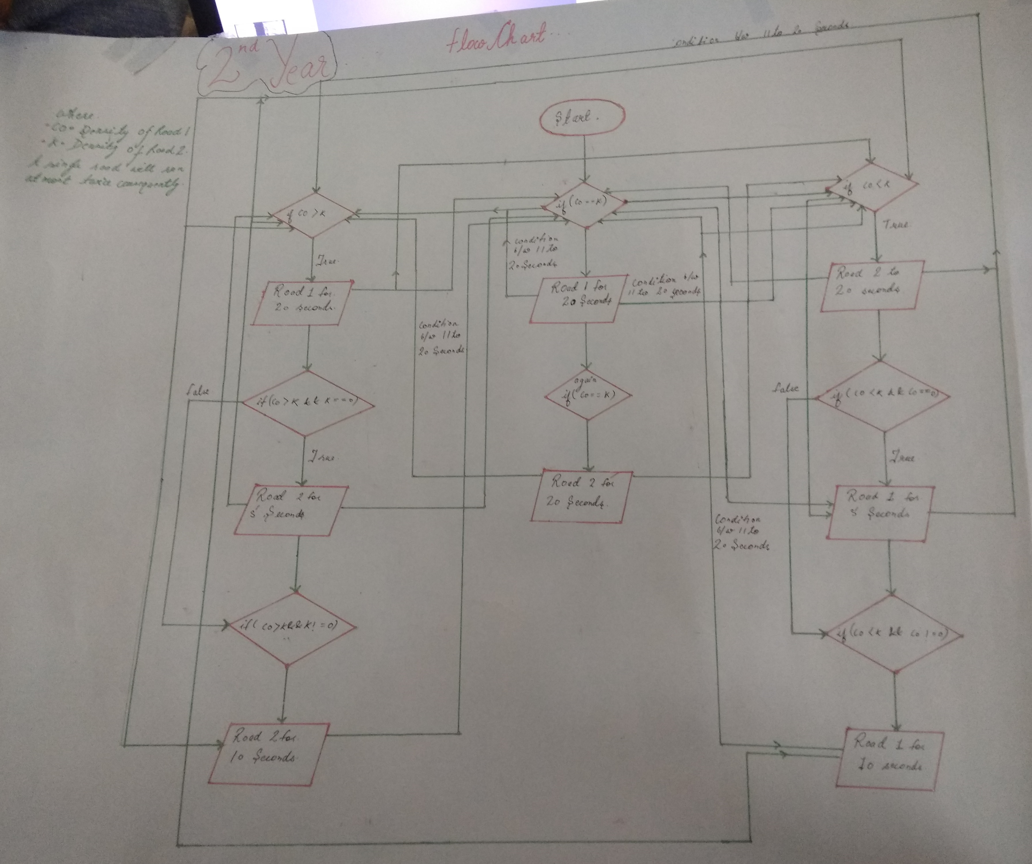

Slide 11
Pros After Implementation:
Time saved on density priority.
Actual time lapsed in one cycle is far less than present scenario.
The changes of breaking the signal is lessened by the barriers.
Timer get stopped after the road becomes empty.
Replacement of traffic police.
The A.T.C is also very efficient at night
Setup cost will not be very high as most component are already present.

Slide 12
HIERARCHICAL STRUCTURE OF IMPLEMENTATION
It would be implemented in 3 layers:
automated traffic system on density basis.
automated traffic system on density basis with barriers.
automated traffic system containing barrier and emergency control.

Slide 14
Impact on the society:
A.T.C implementation leads to less burning of fuel and decrease in pollution.
Using of barriers minimizes the accident and chaos conditions.
Emergency situation such as ambulance,vvip cars etc. are also consider in A.T.C.
Replacement of the Human load(traffic police).
The time saved in traffic leads to efficient work life.

Slide 15
“THE AIM OF OUR PROJECT IS AUTOMATIC TRAFFIC SYSTEM WHICH IS THE IMPLEMENTATION OF MAKING INDIA SMART, i.e the ultimate aim of our Honourable prime minister SHRI. NARENDRA MODI”

Slide 17


Slide 18
Your feedback will very helpful in achieving our goal.

Slide 19
THANK YOU
KIET GROUP OF INSTITUTION ,GHAZIBAD

